Slide 1

Operating System (18CS43)
Module 2
Multi-threaded Programming: overview; Multithreading models; Thread libraries; Threading issues. Process Scheduling; Basic concepts; Scheduling Criteria; Scheduling Algorithms; Multiple-processor scheduling; Thread scheduling. Process Synchronization: Synchronization; The critical section problem; Peterson’s solution; Synchronization hardware; Semaphores; Classical problems of synchronization; Monitors.
T S Bhagavath Singh
Associate Professor
RNS INSTITUTE OF TECHNOLOGY
DEPARTMENT OF INFORMATION SCIENCE AND ENGINEERING
CHANNASANDRA, RR NAGAR POST
Dr. VISHNUVARDHAN ROAD
BENGALURU – 560 098
rnsit.tpo@gmail.com

Slide 2
Multi-threaded Programming
Threads
A thread is a basic unit of CPU utilization.
It comprises a
thread ID,
a program counter,
a register set, and
a stack.
It shares its code section, data section, and other operating-system resources, such as open files and signals with other threads belonging to the same process.
A traditional (or heavyweight) process has a single thread of control.
If a process has multiple threads of control, it can perform more than one task at a time.

Slide 3
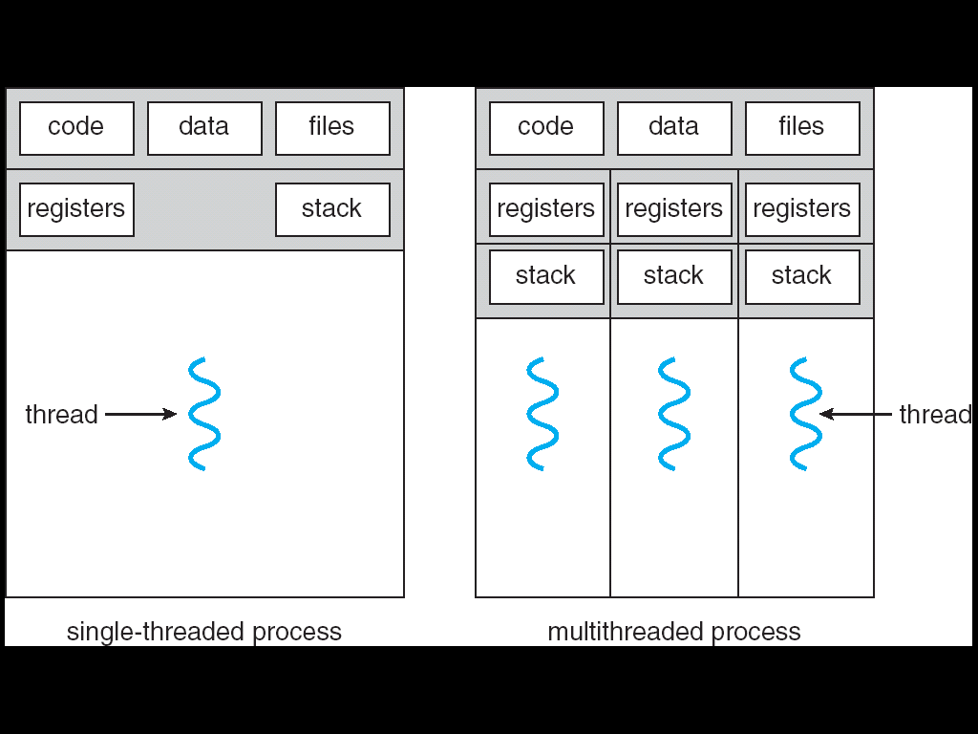
Multi-threaded Programming
The below figure. Illustrates the difference between a traditional single threaded process and a multithreaded process.

Slide 4
Multi-threaded Programming
Motivation
Many software packages are multithreaded.
An application is implemented as a separate process with several threads of control. Eg: A Web browser might have one thread to display images or text while another thread retrieves data from the network.
As process creation takes more time than thread creation it is more efficient to use process that contains multiple threads.
Threads also play an important role in remote procedure call.

Slide 5
Multi-threaded Programming
Benefits
The benefits of multithreaded programming
Responsiveness
Resource Sharing
Economy
Utilization of multiprocessor architectures

Slide 6
Multi-threaded Programming
Multithreading Models
Support for threads may be provided either at user level for user threads or by the kernel for kernel threads.
There must be a relationship between user threads and kernel threads.
Three common ways of establishing this relationship are,
Many-to-One
One-to-One
Many-to-Many Model

Slide 7
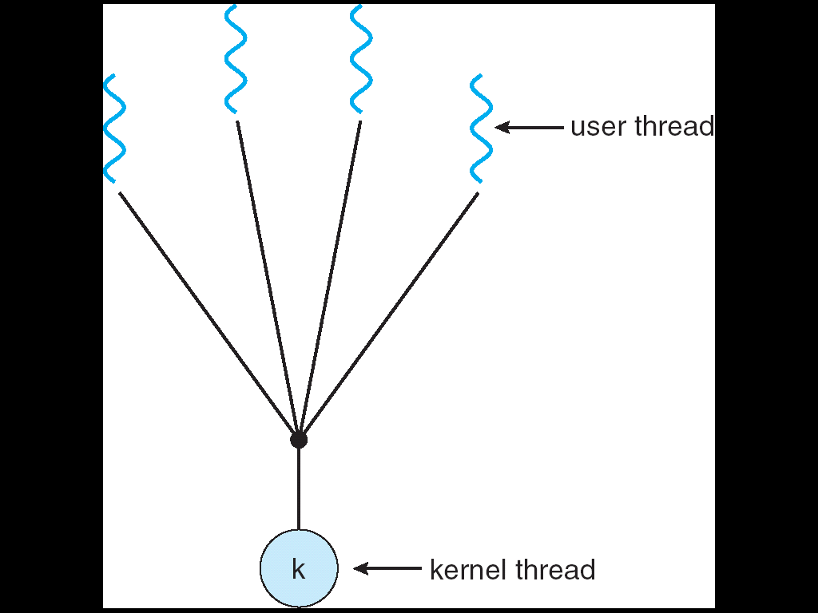
Multi-threaded Programming
Many-to-One
Many user-level threads are mapped to single kernel thread as shown in below figure.
Examples: Solaris Green Threads, GNU Portable Threads

Slide 8
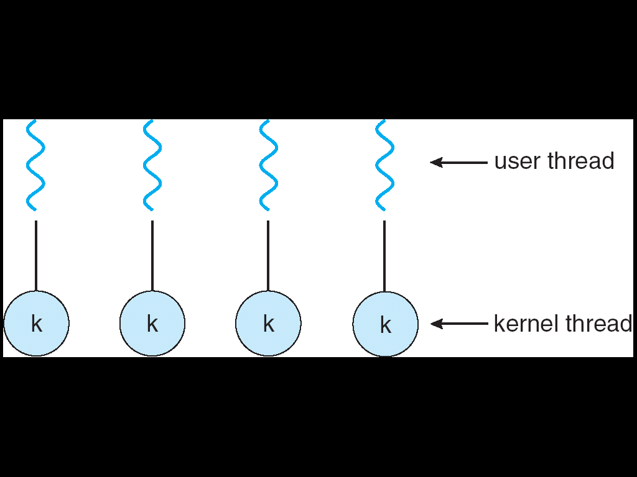
Multi-threaded Programming
2. One-to-One
Each user-level thread maps to kernel thread as shown in figure.
Examples: Windows NT/XP/2000, Linux.

Slide 9
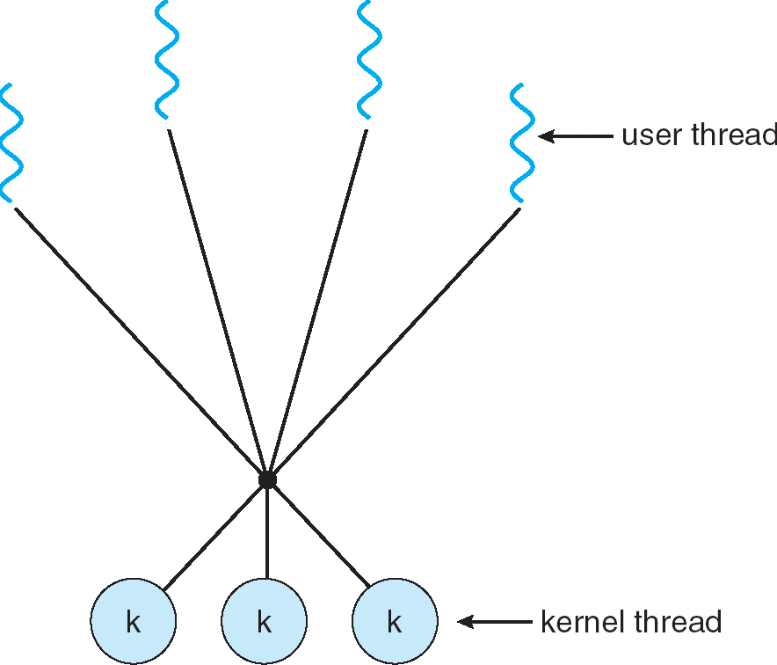
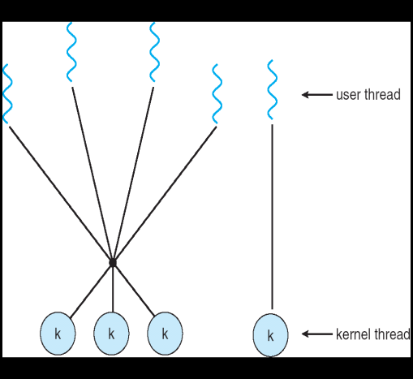
Multi-threaded Programming
Many-to-Many Model
Many-to-One model allows creating more user threads but kernel can schedule only one thread at a time. These drawbacks can be overcome by Many-to-Many model as shown in below figure. (Left side)
Examples: IRIX, HP-UX, Solaris OS.

Slide 10
Multi-threaded Programming
Thread Libraries
A thread library provides the programmer an API for creating and managing threads.
There are two primary ways of implementing a thread library.
The first approach is to provide a library entirely in user space with no kernel support.
The second approach is to implement a kernel-level library supported directly by the operating system.
Three primary thread libraries are
POSIX Pthreads
Win32 threads
Java threads

Slide 11
Multi-threaded Programming
Pthreads
Pthreads, the threads extension of the POSIX standard, may be provided as either a user or kernel-level library.
Pthreads refers to the POSIX standard (IEEE 1003.1c)
This is a specification for thread behavior, not an implementation.
Operating system designers may implement the specification in any way they wish.
Shareware implementations are available in the public domain for the various Windows operating systems as well.

Slide 12
Multi-threaded Programming
Multithreaded C program using the Pthreads API
#include <pthread.h>
#include <stdio.h>
int sum; /* this data is shared by the thread(s) */
void *runner(void *param); /* the thread */
int main(int argc, char *argv[])
{
pthread_t tid; /* the thread identifier */
pthread_attr_t attr; /* set of thread attributes */
if (argc != 2)
{
fprintf(stderr,"usage: a.out <integer value>\n");
return -1;
}

Slide 13
Multi-threaded Programming
if (atoi(argv[1]) < 0)
{
fprintf(stderr,"%d must be>= 0\n",atoi(argv[1]));
return -1;
}
pthread_attr_init(&attr); /* get the default attributes */
pthread_create(&tid,&attr,runner,argv[1]); /* create the thread */
pthread_join(tid,NULL); /* wait for the thread to exit */
printf("sum = %d\n",sum);
}
void *runner(void *param) /* The thread will begin control in this function */
{
int i, upper= atoi(param);
sum = 0;
for (i = 1; i <= upper; i++)
sum += i;
pthread_exit(0) ;
}

Slide 14
Multi-threaded Programming
Win32 Threads
The Win32 thread library is a kernel-level library available on Windows systems.
We must include the windows.h header file when using the Win32 API.
Threads are created in the Win32 API using the CreateThread() function.
These attributes include security information, the size of the stack, and a flag that can be set to indicate if the thread is to start in a suspended state.
The parent thread waits for the child thread using the WaitForSingleObject() function,

Slide 15
Multi-threaded Programming
Java Threads
The Java thread API allows thread creation and management directly in Java programs.
Threads are the fundamental model of program execution in a Java program, and the Java language and its API provide a rich set of features for the creation and management of threads.
All Java programs comprise at least a single thread of control and even a simple Java program consisting of only a main() method runs as a single thread in the JVM.
There are two techniques for creating threads in a Java program. One approach is to create a new class that is derived from the Thread class and to override its run() method.
An alternative and more commonly used technique is to define a class that implements the Runnable interface.

Slide 16
Multi-threaded Programming
Threading Issues
The fork() and exec() System Calls
Thread Cancellation
Signal Handling
Thread pools
Thread-specific data
Scheduler Activation

Slide 17
Threading Issues
The fork() and exec() System Calls
Two versions of fork() system call exists, one that duplicates all threads and another that duplicates only the thread that invoked the fork() system call.
If a thread invokes the exec() system call, the program specified in the parameter to exec() will replace the entire process including all threads.

Slide 18
Threading Issues
Thread Cancellation
Thread cancellation is the task of terminating a thread before it has completed. For example, if multiple threads are concurrently searching through a database and one thread returns the result, the remaining threads might be cancelled.
A thread that is to be cancelled is often referred to as the target thread.
Cancellation of a target thread may occur in two different scenarios:
Asynchronous cancellation: One thread immediately terminates the target thread.
Deferred cancellation: The target thread periodically checks whether it should terminate, allowing it an opportunity to terminate itself in an orderly fashion.

Slide 19
Threading Issues
Signal Handling
A signal is used in UNIX systems to notify a process that a particular event has occurred.
A signal may be received either synchronously or asynchronously, depending on the source of and the reason for the event being signaled.
All signals, whether synchronous or asynchronous, follow the same pattern:
A signal is generated by the occurrence of a particular event.
A generated signal is delivered to a process.
Once delivered, the signal must be handled.

Slide 20
Threading Issues
Thread Pools
The idea behind a thread pool is to create a number of threads at process startup and place them into a pool, where they sit and wait for work.
When a server receives a request, it awakens a thread from this pool and passes the request to it to service.
The benefits of Thread pools are,
Servicing a request with an existing thread is usually faster than waiting to create a thread.
A thread pool limits the number of threads that exist at any one point. This is particularly important on systems that cannot support a large number of concurrent threads.

Slide 21
Threading Issues
Every signal may be handled by one of two possible handlers,
A default signal handler
A user-defined signal handler
Every signal has a default signal handler that is run by the kernel when handling that signal.
This default action can be overridden by a user-defined signal handler that is called to handle the signal.
The following options exist to deliver a signal:
Deliver the signal to the thread to which the signal applies.
Deliver the signal to every thread in the process.
Deliver the signal to certain threads in the process.
Assign a specific thread to receive all signals for the process.

Slide 22
Threading Issues
Thread-Specific Data
Threads belonging to a process share the data of the process. This sharing of data provides one of the benefits of multithreaded programming. But, in some circumstances, each thread might need its own copy of certain data. Such data is called as thread-specific data.
For example, in a transaction-processing system, we might service each transaction in a separate thread. Furthermore, each transaction may be assigned a unique identifier.

Slide 23
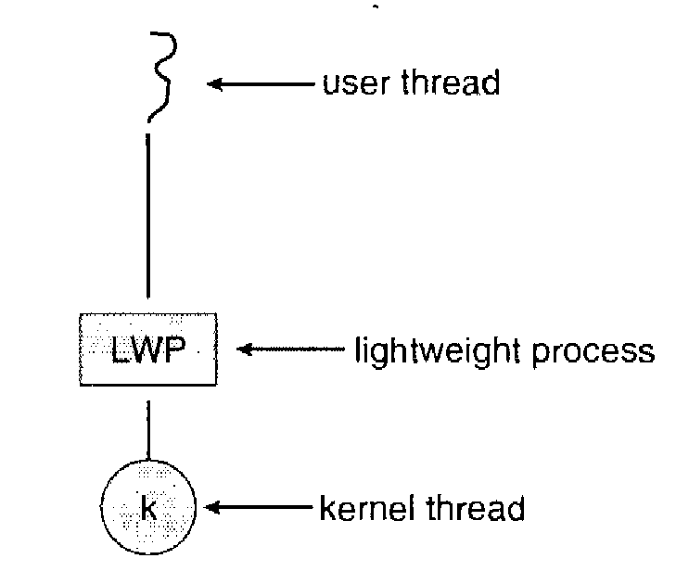
Threading Issues
Scheduler Activations
Many systems implementing either the many-to-many or two-level model place an intermediate data structure between the user and kernel threads. This data structure is known as a lightweight process, or LWP as shown in the following figure.
In a CPU-bound application running on a single processor only one thread can run at once, so one LWP is sufficient. An application that is I/O- intensive may require multiple LWPs to execute.
One scheme for communication between the user-thread library and the kernel is known as scheduler activation.

Slide 24
Differences
The differences between process and thread are,
 | Process | Thread
1. | It is called heavyweight process. | It is called lightweight process.
2. | Process switching needs interface with OS. | Thread switching does not need interface with OS.
3. | Multiple processes use more resources than multiple threads. | Multiple threaded processes use fewer resources than multiple processes.
4. | In multiple process implementations each process executes same code but has its own memory and file resources. | All threads can share same set of open files.
5. | If one server process is blocked no other server process can execute until the first process unblocked. | While one server thread is blocked and waiting, second thread in the same task could run.
6. | In multiple processes each process operates independently of others. | One thread can read, write or even completely wipeout another threads stack.

Slide 25
PROCESS SHEDULING
Basic Concepts
In a single-processor system, only one process can run at a time and others must wait until the CPU is free and can be rescheduled.
The objective of multiprogramming is to have some process running at all times, to maximize CPU utilization.
With multiprogramming, several processes are kept in memory at one time. When one process has to wait, the operating system takes the CPU away from that process and gives the CPU to another process.
The CPU is one of the primary computer resources. Thus, its scheduling is central to Operating-system design.

Slide 26
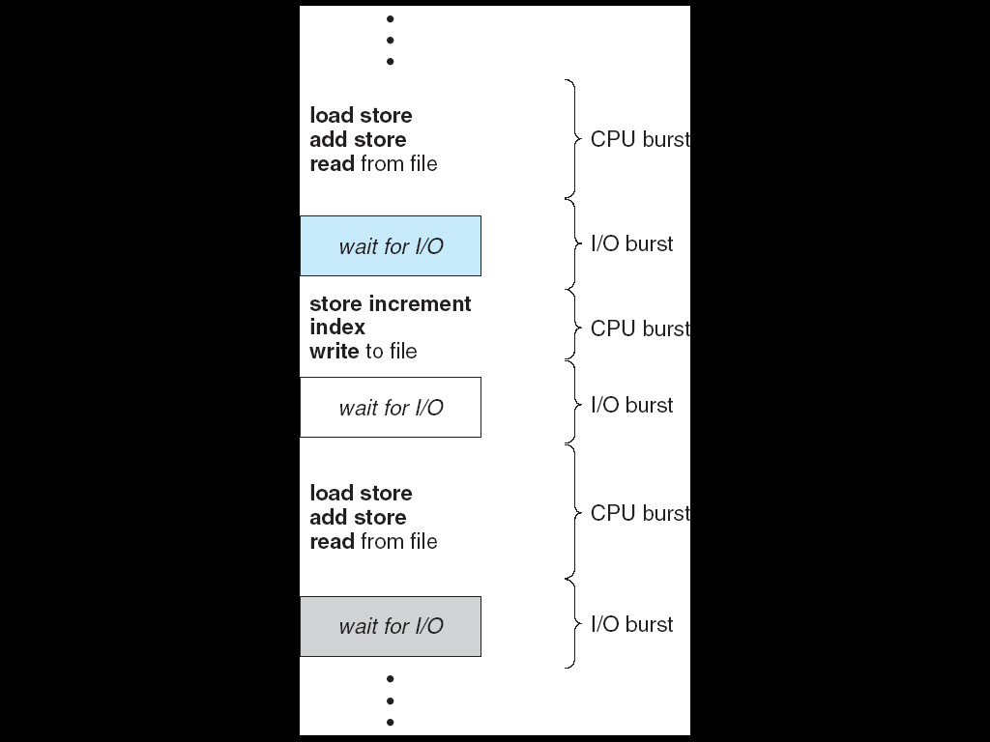
PROCESS SHEDULING
CPU–I/O Burst Cycle
Process execution consists of a cycle of CPU execution and I/O wait
Process execution starts with CPU burst and this is followed by I/O burst as shown in below figure.
The final CPU burst ends with a system request to terminate execution.

Slide 27
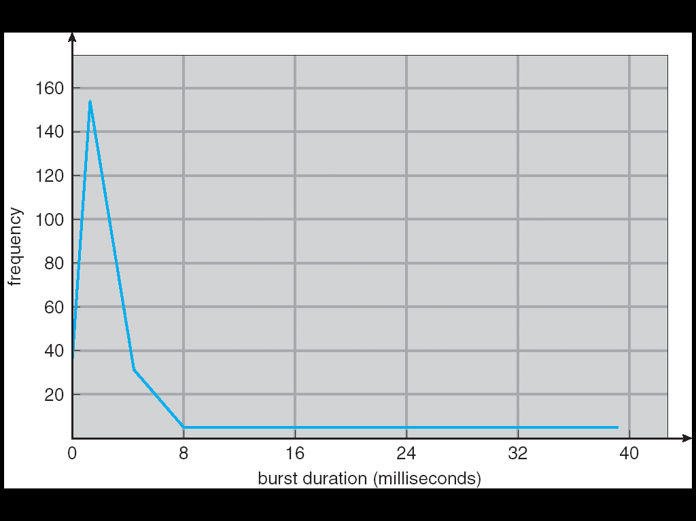
PROCESS SHEDULING
The duration of CPU bursts vary from process to process and from computer to computer.
The frequency curve is as shown below figure.

Slide 28
PROCESS SHEDULING
CPU Scheduler
Whenever the CPU becomes idle, the operating system must select one of the processes in the ready queue to be executed. This selection is carried out by the short-term scheduler (or CPU scheduler).
The scheduler selects a process from the processes in memory that are ready to execute and allocates the CPU to that process.
A ready queue can be implemented as a FIFO queue, a priority queue, a tree, or simply an unordered linked list. But all the processes in the ready queue are lined up waiting for a chance to run on the CPU. The records in the queues are Process Control Blocks (PCBs) of the processes.

Slide 29
PROCESS SHEDULING
Preemptive scheduling
CPU-scheduling decisions may take place under the following four circumstances.
When a process switches from the running state to the waiting state (for example, as the result of an I/O request or an invocation of wait for the termination of one of the child processes)
When a process switches from the running state to the ready state (for example, when an interrupt occurs)
When a process switches from the waiting state to the ready state (for example, at completion of I/O)
When a process terminates
When scheduling takes place only under circumstances 1 and 4, we say that the scheduling scheme is nonpreemptive or cooperative; otherwise, it is preemptive.

Slide 30
PROCESS SHEDULING
Dispatcher
Another component involved in the CPU-scheduling function is the dispatcher.
The dispatcher is the module that gives control of the CPU to the process selected by the short-term scheduler.
This function involves the following:
Switching context
Switching to user mode
Jumping to the proper location in the user program to restart that program
The dispatcher should be as fast as possible, since it is invoked during every process switch.
The time it takes for the dispatcher to stop one process and start another running is known as the dispatch latency.

Slide 31
PROCESS SHEDULING
Scheduling Criteria
Many criteria have been suggested for comparing CPU scheduling algorithms. The criteria include the following:
CPU utilization
Throughput
Turnaround time
Waiting time
Response time

Slide 32
Scheduling Algorithms
CPU Scheduling deals with the problem of deciding which of the processes in the ready queue is to be allocated the CPU.
Following are some scheduling algorithms,
FCFS Scheduling.
Round Robin Scheduling.
SJF Scheduling.
Priority Scheduling.
Multilevel Queue Scheduling.
Multilevel Feedback Queue Scheduling.

Slide 33
Scheduling Algorithms
First-Come-First-Served (FCFS) Scheduling
The simplest CPU-scheduling algorithm is the first-come, first-served (FCFS) scheduling algorithm.
With this scheme, the process that requests the CPU first is allocated the CPU first.
The implementation of the FCFS policy is easily managed with a FIFO queue.
When a process enters the ready queue, its PCB is linked onto the tail of the queue.
When the CPU is free, it is allocated to the process at the head of the queue. The running process is then removed from the queue.

Slide 34
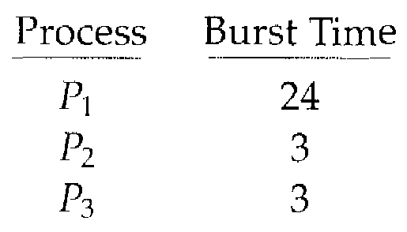
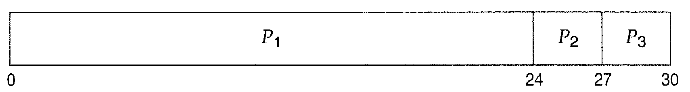
Scheduling Algorithms
The average waiting time under the FCFS policy is often quite long. Consider the following set of processes that arrive at time 0, with the length of the CPU burst given in milliseconds:
If the processes arrive in the order P₁, P₂, P₃, and are served in FCFS order, we get the result shown in the following Gantt chart:

Slide 35
Scheduling Algorithms
The waiting time is 0 milliseconds for process P₁, 24 milliseconds for process P₂, and 27 milliseconds for process P₃.
Thus, the average waiting time is (0 + 24 + 27)/3 = 17 milliseconds.
The FCFS scheduling algorithm is nonpreemptive.

Slide 36
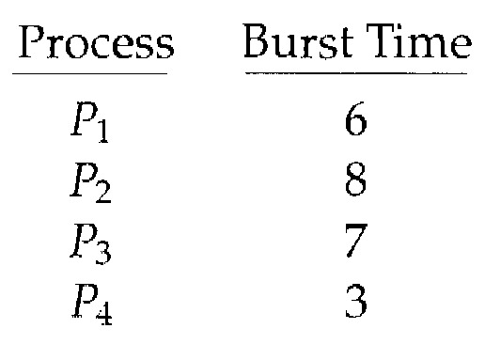
Scheduling Algorithms
Shortest-Job-First Scheduling
This algorithm associates with each process the length of the process's next CPU burst.
When the CPU is available, it is assigned to the process that has the smallest next CPU burst.
If the next CPU bursts of two processes are the same, FCFS scheduling is used to break the tie.
As an example of SJF scheduling, consider the following set of processes, with the length of the CPU burst given in milliseconds:

Slide 37
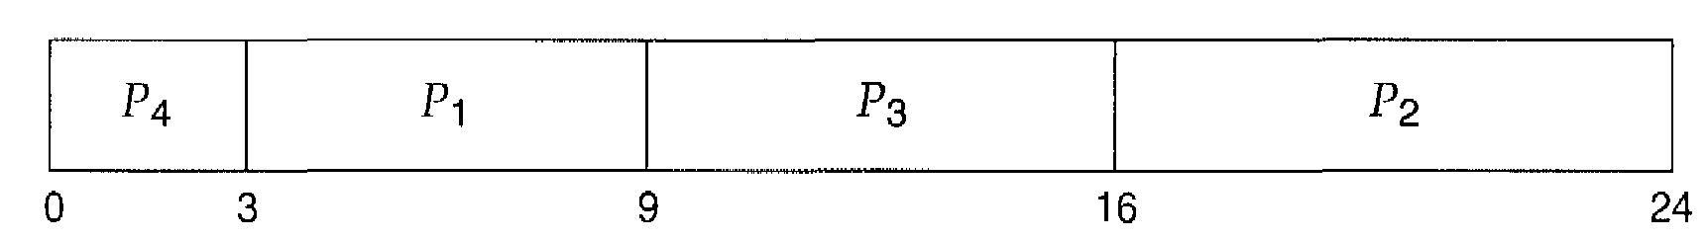
Scheduling Algorithms
Using SJF scheduling, we would schedule these processes according to the following Gantt chart:
The waiting time is 3 milliseconds for process P₁, 16 milliseconds for process P₂, 9 milliseconds for process P₃, and 0 milliseconds for process P₄. Thus, the average waiting time is (3 + 16 + 9 + 0)/4 = 7 milliseconds.
The SJF scheduling algorithm is optimal.
The SJF algorithm can be either preemptive or nonpreemptive.
SJF scheduling is sometimes called shortest-remaining-time-first scheduling.

Slide 38
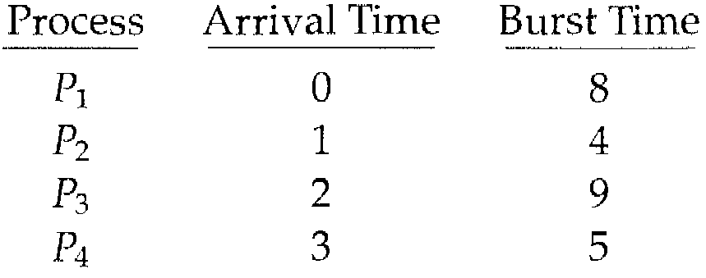
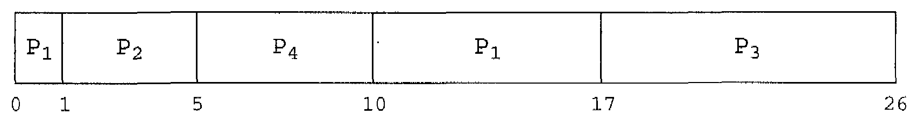
Scheduling Algorithms
As an example, consider the following four processes, with the length of the CPU burst given in milliseconds:
If the processes arrive at the ready queue at the times shown and need the indicated burst times, then the resulting preemptive SJF schedule is as depicted in the following Gantt chart:

Slide 39
Scheduling Algorithms
Process P₁ is started at time 0, since it is the only process in the queue. Process P₂ arrives at time 1.
The remaining time for process P₁ (7 milliseconds) is larger than the time required by process P₂ (4 milliseconds), so process P₁ is preempted, and process P₂ is scheduled.
The average waiting time for this example is
((10 -1) + (1-1) + (17 -2) + (5- 3))/4 = 26/4 = 6.5 milliseconds.
Nonpreemptive SJF scheduling would result in an average waiting time of 7.75 milliseconds.

Slide 40
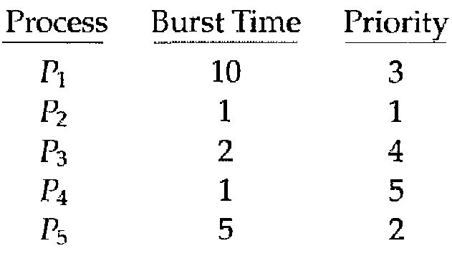
Scheduling Algorithms
Priority Scheduling
A priority is associated with each process, and the CPU is allocated to the process with the highest priority.
Equal-priority processes are scheduled in FCFS order.
An SJF algorithm is simply a priority algorithm where the priority (p) is the inverse of the (predicted) next CPU burst. The larger the CPU burst, the lower the priority, and vice versa.
As an example, consider the following set of processes, assumed to have arrived at time 0, in the order P₁, P₂, … , P₅, with the length of the CPU burst given in milliseconds:

Slide 41
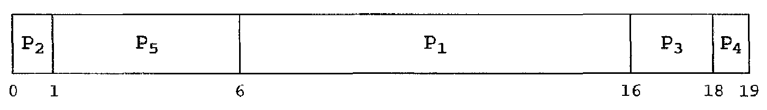
Scheduling Algorithms
Using priority scheduling, we would schedule these processes according to the following Gantt chart:
The average waiting time is 8.2 milliseconds.
Priority scheduling can be either preemptive or nonpreemptive. When a process arrives at the ready queue, its priority is compared with the priority of the currently running process.
A preemptive priority scheduling algorithm will preempt the CPU if the priority of the newly arrived process is higher than the priority of the currently running process.
A nonpreemptive priority scheduling algorithm will simply put the new process at the head of the ready queue.

Slide 42
Scheduling Algorithms
A major problem with priority scheduling algorithms is indefinite blocking, or starvation. A process that is ready to run but waiting for the CPU can be considered blocked.
A stream of higher-priority processes can prevent a low-priority process from ever getting the CPU.
A solution to the problem of indefinite blockage of low-priority processes is aging.
Aging is a technique of gradually increasing the priority of processes that wait in the system for a long time.

Slide 43
Scheduling Algorithms
Round-Robin Scheduling
The round-robin (RR) scheduling algorithm is designed especially for timesharing systems.
It is similar to FCFS scheduling, but preemption is added to switch between processes.
A small unit of time, called a time quantum or time slice, is defined. A time quantum is generally from 10 to 100 milliseconds.
The ready queue is treated as a circular queue. The CPU scheduler goes around the ready queue, allocating the CPU to each process for a time interval of up to 1 time quantum.
To implement RR scheduling, we keep the ready queue as a FIFO queue of processes. New processes are added to the tail of the ready queue.

Slide 44
Scheduling Algorithms
The CPU scheduler picks the first process from the ready queue, sets a timer to interrupt after 1 time quantum, and dispatches the process. One of two things will then happen.
The process may have a CPU burst of less than 1 time quantum. In this case, the process itself will release the CPU voluntarily. The scheduler will then proceed to the next process in the ready queue.
Otherwise, if the CPU burst of the currently running process is longer than 1 time quantum, the timer will go off and will cause an interrupt to the operating system. A context switch will be executed, and the process will be put at the tail of the ready queue. The CPU scheduler will then select the next process in the ready queue.
The average waiting time under the RR policy is often long.

Slide 45
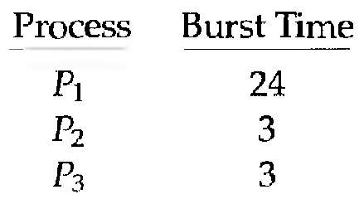
Scheduling Algorithms
Consider the following set of processes that arrive at time 0, with the length of the CPU burst given in milliseconds:
If we use a time quantum of 4 milliseconds, then process P₁ gets the first 4 milliseconds. Since it requires another 20 milliseconds, it is preempted after the first time quantum, and the CPU is given to the next process in the queue ie. process P₂. Since process P₂ does not need 4 milliseconds, it quits before its time quantum expires.
The CPU is then given to the next process P₃. Once each process has received 1 time quantum, the CPU is returned to process P₁ for an additional time quantum.

Slide 46
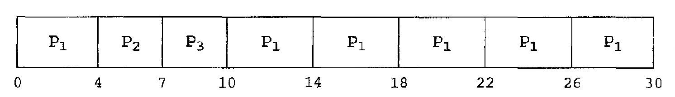
Scheduling Algorithms
The resulting RR schedule is
The average waiting time is 17/3 = 5.66 milliseconds.
The RR scheduling algorithm is thus preemptive.

Slide 47
Scheduling Algorithms
Multilevel Queue Scheduling
Another class of scheduling algorithms has been created for situations in which processes are easily classified into different groups. For example, a common division is made between foreground (interactive) processes and background (batch) processes.
These two types of processes have different response-time requirements and may have different scheduling needs.
Foreground processes have priority over background processes.

Slide 48
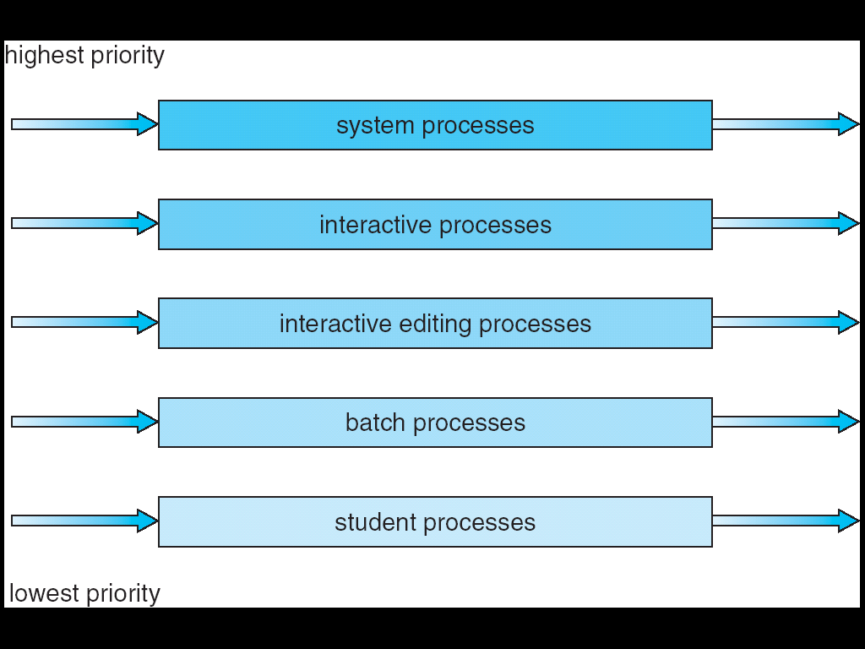
Scheduling Algorithms
A multilevel queue scheduling algorithm partitions the ready queue into several separate queues as shown in below figure.
The processes are permanently assigned to one queue based on some property of the process, such as memory size, process priority, or process type.

Slide 49
Scheduling Algorithms
An example of a multilevel queue scheduling algorithm with five queues, listed below in order of priority:
1. System processes
2. Interactive processes
3. Interactive editing processes
4. Batch processes
5. Student processes

Slide 50
Scheduling Algorithms
Multilevel Feedback-Queue Scheduling
When the multilevel queue scheduling algorithm is used, processes are permanently assigned to a queue when they enter the system.
The multilevel feedback-queue scheduling algorithm allows a process to move between queues. The idea is to separate processes according to the characteristics of their CPU bursts.
If a process uses too much CPU time, it will be moved to a lower-priority queue. This scheme leaves I/O-bound and interactive processes in the higher-priority queues.
A process that waits too long in a lower-priority queue may be moved to a higher-priority queue. This form of aging prevents starvation.

Slide 51
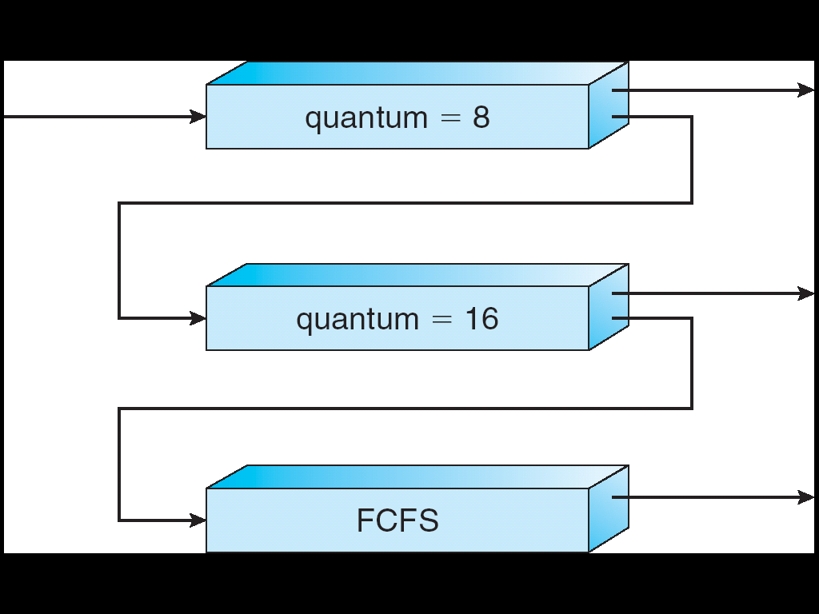
Scheduling Algorithms
For example, consider a multilevel feedback-queue scheduler with three queues, numbered from 0 to 2 as shown in below figure.
The scheduler first executes all processes in queue 0. Only when queue 0 is empty it will execute processes in queue 1.
Similarly, processes in queue 2 will only be executed if queues 0 and 1 are empty. A process that arrives for queue 1 will preempt a process in queue 2.
A process in queue 1 will in turn be preempted by a process arriving for queue 0.

Slide 52
Scheduling Algorithms
A multilevel feedback-queue scheduler is defined by the following parameters:
The number of queues.
The scheduling algorithm for each queue.
The method used to determine when to upgrade a process to a higher-priority queue.
The method used to determine when to demote a process to a lower-priority queue.
The method used to determine which queue a process will enter when that process needs service.

Slide 53
Multiple-Processor Scheduling
Approaches to Multiple-Processor Scheduling
One approach to CPU scheduling in a multiprocessor system is where all scheduling decisions, I/O processing, and other system activities are handled by a single processor i.e., the master server. The other processors execute only user code. This asymmetric multiprocessing is simple because only one processor accesses the system data structures, reducing the need for data sharing.
A second approach uses symmetric multiprocessing (SMP), where each processor is self-scheduling. All processes may be in a common ready queue, or each processor may have its own private queue of ready processes.

Slide 54
Multiple-Processor Scheduling
Some of the issues related to SMP are,
a. Processor Affinity
The data most recently accessed by the process is populated in the cache for the processor and successive memory accesses by the process are often satisfied in cache memory.
If the process migrates to another processor, the contents of cache memory must be invalidated for the processor being migrated from, and the cache for the processor being migrated to must be re-populated. Because of the high cost of invalidating and re-populating caches, most SMP systems try to avoid migration of processes from one processor to another and instead tries to keep a process running on the same processor. This is known as processor affinity, i.e., a process has an affinity for the processor on which it is currently running.

Slide 55
Multiple-Processor Scheduling
b. Load Balancing
On SMP systems, it is important to keep the workload balanced among all processors to utilize the benefits of having more than one processor. Otherwise, one or more processors may sit idle while other processors have high workloads along with lists of processes awaiting the CPU.
Load balancing attempts to keep the workload evenly distributed across all processors in an SMP system.
There are two general approaches to load balancing: push migration and pull migration.
With push migration, a specific task periodically checks the load on each processor and if it finds an imbalance it evenly distributes the load by moving (or pushing) processes from overloaded to idle or less-busy processors.
Pull migration occurs when an idle processor pulls a waiting task from a busy processor.

Slide 56
Multiple-Processor Scheduling
c. Symmetric Multithreading
SMP systems allow several threads to run concurrently by providing multiple physical processors.
An alternative strategy is to provide multiple logical processors rather than physical processors. Such a strategy is known as symmetric multithreading (or SMT).
The idea behind SMT is to create multiple logical processors on the same physical processor, presenting a view of several logical processors to the operating system, even on a system with only a single physical processor.
Each logical processor has its own architecture state, which includes general-purpose and machine-state registers and is responsible for its own interrupt handling, meaning that interrupts are delivered to and handled by logical processors rather than physical ones. Otherwise, each logical processor shares the resources of its physical processor, such as cache memory and buses.

Slide 57
Thread Scheduling
The kernel-level threads are being scheduled by the operating system.
User-level threads are managed by a thread library, and the kernel is unaware of them.
One distinction between user-level and kernel-level threads lies in how they are scheduled.
A scheme known as process-contention scope (PCS), means competition for the CPU takes place among threads belonging to the same process.
To decide which kernel thread to schedule onto a CPU, the kernel uses system-contention scope (SCS).

Slide 58
PROCESS SYNCHRONIZATION
Race condition: A situation where several processes access and manipulate the same data concurrently and the outcome of the execution depends on the particular order in which the access takes place.
To guard against race condition, we require that the processes must be synchronized in some way.
The critical-section problem
Consider a system consisting of n processes {P₀, P₁... P_{n-1}}. Each process has a segment of code, called a critical section, in which the process may be changing the common variables, updating a table, writing a file, and so on.

Slide 59
The important feature of the system is that, when one process is executing in its critical section, no other process is to be allowed to execute in its critical section. That is, no two processes are executing in their critical sections at the same time.
The critical-section problem is to design a protocol that the processes can use to cooperate.
Each process must request permission to enter its critical section. The section of code implementing this request is the entry section.
The critical section may be followed by an exit section.
The remaining code is the remainder section.

Slide 60
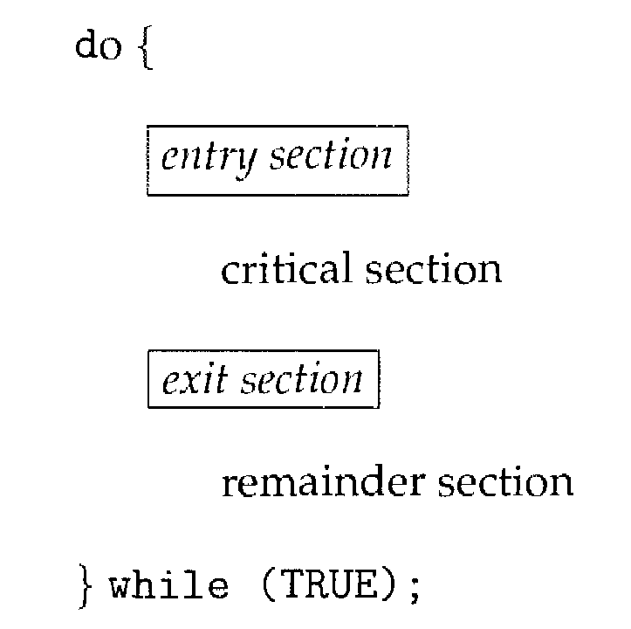
The general structure of a typical process P_{i}, is shown in the following figure
A solution to the critical-section problem must satisfy the following three requirements:
Mutual exclusion
Progress.
Bounded waiting

Slide 61
Two general approaches are used to handle critical sections in operating systems.
1. Pre-emptive kernel
2. Nonpreemptive kernel.

Slide 62
Peterson’s solution
A classic software-based solution to the critical-section problem is known as Peterson's solution.
Peterson's solution is restricted to two processes that alternate execution between their critical sections and remainder sections.
The processes are numbered P₀ and P₁ or P_{i} and P_{j} where j=1-i.
Peterson's solution requires two data items to be shared between the two processes,
int turn;
boolean flag[2];
The variable turn indicates whose turn it is to enter its critical section. That is, if turn = = i, then process P_{i}, is allowed to execute in its critical section.
The flag array is used to indicate if a process is ready to enter its critical section. For example, if flag[i] is true, this value indicates that P_{i} is ready to enter its critical section.
To enter the critical section, process P_{i} first sets flag[i] to be true and then sets turn to the value j, thereby asserting that if the other process wishes to enter the critical section, it can do so.

Slide 63
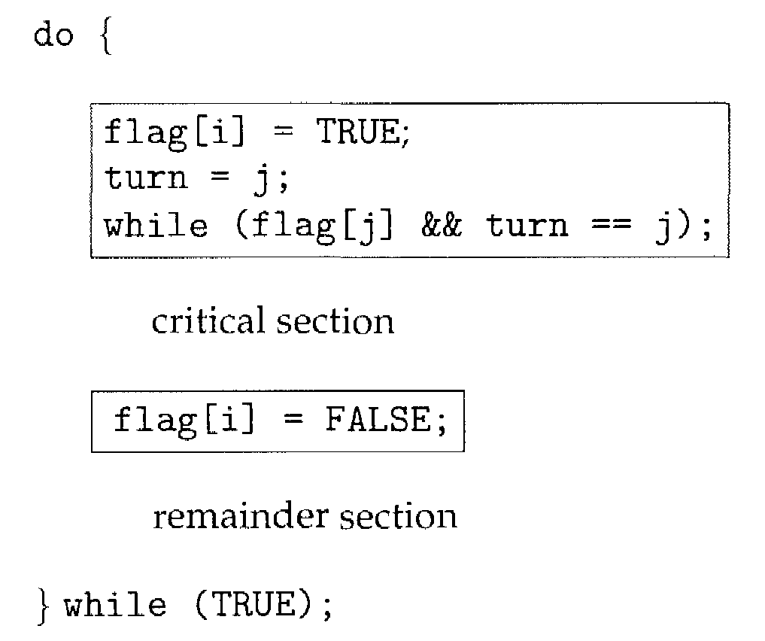
The following algorithm describes the structure of P_{i} in Peterson’s solution

Slide 64
To prove that this solution is correct, we need to show that,
1. Mutual exclusion is preserved.
2. The progress requirement is satisfied.
3. The bounded-waiting requirement is met.

Slide 65
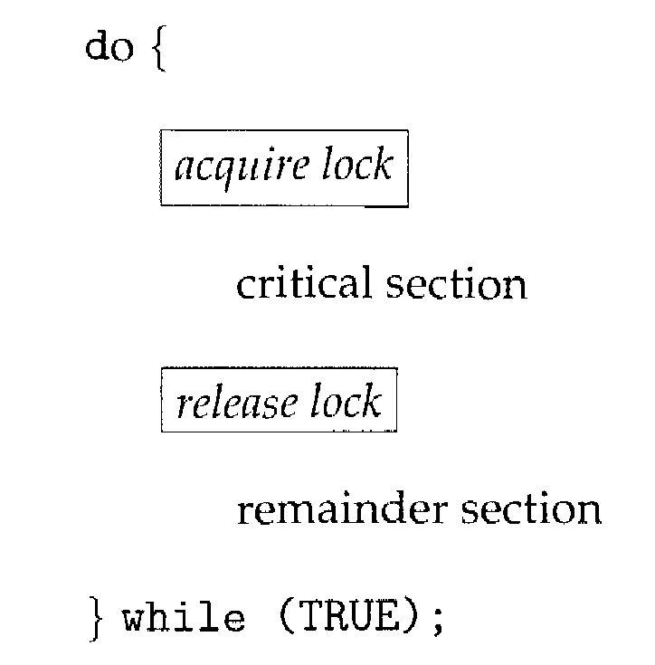
Synchronization hardware
Any solution to the critical-section problem requires a simple tool called a lock. Race conditions are prevented by requiring that critical regions be protected by locks.
That is, a process must acquire a lock before entering a critical section; it releases the lock when it exits the critical section. This is illustrated below,
Hardware features can make any programming task easier and improve system efficiency.

Slide 66
Scheduling Algorithms
We can use these special instructions to solve the critical-section problem in a relatively simple manner. The TestAndSet() instruction can be defined as below,
boolean TestAndSet(boolean *target)
{
boolean rv = *target;
*target = TRUE;
return rv;
}
The important characteristic is that this instruction is executed atomically. Thus, if two TestAndSet() instructions are executed simultaneously (each on a different CPU), they will be executed sequentially in some arbitrary order.

Slide 67
Scheduling Algorithms
The Swap() instruction, in contrast to the TestAndSet() instruction, operates on the contents of two words as shown below,
void Swap(boolean *a, boolean *b)
{
boolean temp = *a;
*a = *b;
*b = temp;
}
It is executed atomically. If the machine supports the Swap() instruction, then mutual exclusion can be provided as follows.

Slide 68
Semaphores
The hardware-based solutions to the critical-section problem are complicated for application programmers to use.
To overcome this difficulty, we can use a synchronization tool called a semaphore.
A semaphore S is an integer variable it is accessed only through two standard atomic operations: wait () and signal (). The wait () operation was termed as P; signal () was called V.
The definition of wait() is as follows,
wait(S)
{
while S<= 0; // no-op
S--;
}

Slide 69
Semaphores
The definition of signal() is as follows,
signal(S)
{
S++ ;
}
The wait() and signal() operations must be executed indivisibly. That is, when one process modifies the semaphore value, no other process can simultaneously modify that same semaphore value.

Slide 70
Semaphores
Usage
Operating systems often distinguish between counting and binary semaphores.
The value of a counting semaphore can range over an unrestricted domain.
The value of a binary semaphore can range only between 0 and 1.
Binary semaphores are known as mutex locks, as they are locks that provide mutual exclusion.
We can use binary semaphores to deal with the critical-section problem for multiple processes.

Slide 71
Semaphores
The n processes share a semaphore, mutex, initialized to 1. Each process P_{i} is organized as shown,
do {
waiting(mutex);
// critical section
signal (mutex) ,
// remainder section
} while (TRUE);
Counting semaphores can be used to control access to a given resource consisting of a finite number of instances.

Slide 72
Semaphores
We can also use semaphores to solve various synchronization problems. For example, consider two concurrently running processes: P₁ with a statement S₁ and P₂ with a statement S₂. Suppose we require that P₂ be executed only after S₁ has completed. We can implement this by letting P₁ and P₂ to share a common semaphore synch, initialized to 0, and by inserting the statements in process P₁, and the statements in process P₂.
S₁;
signal(synch);
wait(synch);
S₂;
Because synch is initialized to 0, P₂ will execute S₂ only after P₁ has invoked signal (synch), which is after statement S₁ has been executed.

Slide 73
Semaphores
Implementation
The main disadvantage of the semaphore definition given here is that it requires busy waiting. While a process is in its critical section, any other process that tries to enter its critical section must loop continuously in the entry code.
This type of semaphore is also called a spin lock because the process "spins" while waiting for the lock.
To implement semaphores under this definition, we define a semaphore as a "C' struct:
typedef struct {
int value;
struct process *list;
} semaphore;

Slide 74
Deadlocks and Starvation
The implementation of a semaphore with a waiting queue may result in a deadlock situation where two or more processes are waiting indefinitely for an event that can be caused only by one of the waiting processes. When such a state is reached, these processes are said to be deadlocked.
To illustrate this, we consider a system consisting of two processes, P₀ and P₁, each accessing two semaphores, S and Q, set to the value 1:
P₀ P₁
wait(S); wait(Q);
wait(Q); wait(S);
. .
. .
. .
signal(S); signal(Q);
signal(Q); signal(S);

Slide 75
Deadlocks and Starvation
Suppose that P₀ executes wait(S) and then P₁ executes wait(Q). When P₀ executes wait(Q), it must wait until P₁ executes signal(Q). Similarly, when P₁ executes wait(S), it must wait until P₀ executes signal(S). Since these signal() operations cannot be executed, P₀ and P₁ are deadlocked.
Another problem related to deadlocks is indefinite blocking, or starvation, a situation in which processes wait indefinitely within the semaphore.

Slide 76
Classic problems of Synchronization
Classic problems of Synchronization
1. Bounded-buffer problem
2. The Readers-Writers Problem
3. The Dining-Philosophers Problem

Slide 77
Classic problems of Synchronization
1. Bounded-buffer problem
The code for the producer process is shown:
do{
// produce an item in nextp
...
wait(empty);
wait (mutex);
...
// add nextp to buffer
...
signal(mutex);
signal (full);
}while (TRUE);

Slide 78
1. Bounded-buffer problem cont..
The code for the consumer process is shown:
do {
wait (full);
wait(mutex);
...
//remove an item from buffer to nextc
...
signal(mutex);
signal(empty);
//consume the item in nextc
...
}while (TRUE);
We can interpret this code as the producer producing full buffers for the consumer or as the consumer producing empty buffers for the producer.

Slide 79
2. The Readers-Writers Problem
A database is to be shared among several concurrent processes. Some of these processes may want only to read the database, whereas others may want to update (that is, to read and write) the database.
Readers - processes that only read the database.
Writers - processes performing both read and write (update).
Problem: If two readers access the shared data simultaneously, no problem will result. But if a writer and some other thread (either a reader or a writer) access the database simultaneously, problem arises.
This synchronization problem is referred to as the readers-writers problem.

Slide 80
2. The Readers-Writers Problem
The readers-writers problem has several variations.
The first readers-writers problem, which requires that no reader must be kept waiting unless a writer has already obtained permission to use the shared object.
The second readers-writers problem requires that, once a writer is ready, that writer performs its write as soon as possible.
A solution to either problem may result in starvation. In the first case, writers may starve; in the second case, readers may starve.
In the solution to the first readers-writers problem, the reader processes share the following data structures:
semaphore mutex, wrt;
int readcount;

Slide 81
2. The Readers-Writers Problem
The semaphores mutex and wrt are initialized to 1and readcount is initialized
to 0.
The semaphore wrt is common to both reader and writer processes.
The mutex semaphore is used to ensure mutual exclusion when the variable readcount is updated.
The readcount variable keeps track of how many processes are currently reading the object.
The semaphore wrt functions as a mutual-exclusion semaphore for the writers.

Slide 82
2. The Readers-Writers Problem cont..
The code for a writer process is,
do {
wait (wrt);
…..
// writing is performed
signal (wrt);
} while (TRUE);

Slide 83
2. The Readers-Writers Problem cont..
The code for a reader process is shown,
do {
wait (mutex);
readcount++;
if (readcount = = 1)
wait (wrt);
signal(mutex);
……..
// reading is performed
……..
wait(mutex);
readcount--;
if (readcount= = 0)
signal(wrt);
signal(mutex);
} while (TRUE);

Slide 84
3. The Dining-Philosophers Problem
Consider five philosophers who spend their lives thinking and eating.
The philosophers share a circular table surrounded by five chairs, each belonging to one philosopher.
In the centre of the table is a bowl of rice, and the table is laid with five single chopsticks (below figure).
When a philosopher is thinking, she does not interact with her colleagues.
When a philosopher gets hungry, she tries to pick up the two chopsticks that are closest to her (the chopsticks that are between her and her left and right neighbors).

Slide 85
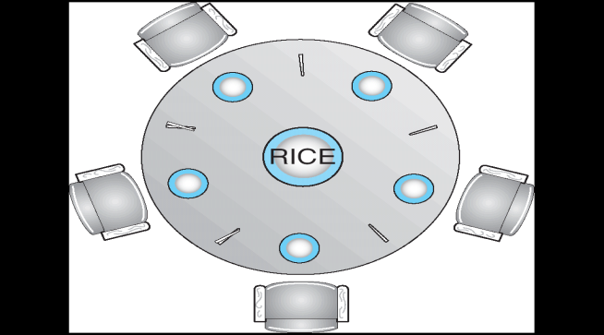
3. The Dining-Philosophers Problem
When a hungry philosopher has both her chopsticks at the same time, she eats without releasing her chopsticks. When she is finished eating, she puts down both of her chopsticks and starts thinking again.
figure: The situation of the dining philosophers
One simple solution is to represent each chopstick with a semaphore

Slide 86
3. The Dining-Philosophers Problem
A philosopher tries to grab a chopstick by executing a wait() operation on that semaphore; she releases her chopsticks by executing the signal() operation on the appropriate semaphores.
Thus, the shared data are
semaphore chopstick[5];
where all the elements of chopstick are initialized to 1.

Slide 87
3. The Dining-Philosophers Problem
The structure of philosopher i is shown below,
do {
wait(chopstick[i]);
k[(i+l) % 5]);
……
// eat
........
signal(chopstick[i]);
signal(chopstick[(i+l) % 5]);
………
// think
..........
} while (TRUE);

Slide 88
3. The Dining-Philosophers Problem
The disadvantage is it could create a deadlock. Suppose that all five philosophers become hungry simultaneously and each grabs her left chopstick. All the elements of chopstick will now be equal to 0. When each philosopher tries to grab her right chopstick, she will be delayed forever.
Several possible remedies to the deadlock problem are available.
Allow at most four philosophers to be sitting simultaneously at the table.
Allow a philosopher to pick up her chopsticks only if both chopsticks are available (to do this, she must pick them up in a critical section).
Use an asymmetric solution; that is, an odd philosopher picks up first her left chopstick and then her right chopstick, whereas an even philosopher picks up her right chopstick and then her left chopstick.

Slide 89
Monitors
All processes share a semaphore variable mutex, which is initialized to 1. Each process must execute wait(mutex) before entering the critical section and signal(mutex) afterward. If this sequence is not observed, two processes may be in their critical sections simultaneously.
This may result in various difficulties.
Suppose that a process interchanges the order in which the wait() and signal() operations on the semaphore mutex are executed, resulting in the following execution:
signal(mutex);
……
critical section
……
wait(mutex);
In this situation, several processes may be executing in their critical sections simultaneously, violating the mutual-exclusion requirement. This error may be discovered only if several processes are simultaneously active in their critical sections.

Slide 90
Monitors
Suppose that a process replaces signal (mutex) with wait (mutex). That is, it executes
wait(mutex);
……
critical section
……
wait(mutex);
In this case, a deadlock will occur.
Suppose that a process omits the wait (mutex), or the signal (mutex), or both. In this case, either mutual exclusion is violated or a deadlock will occur.

Slide 91
Monitors
To deal with errors when semaphores are used incorrectly, one fundamental high-level synchronization construct-the monitor is used.
The syntax of a monitor is shown below,
monitor monitor name
{
// shared variable declarations
procedure P1 ( . . . ) {
………
}
procedure P2 ( . . . ) {
……….
}
.
.
procedure Pn ( . . . ) {
…………
}
initialization code ( . . . ) {
…………
}
}

Slide 92
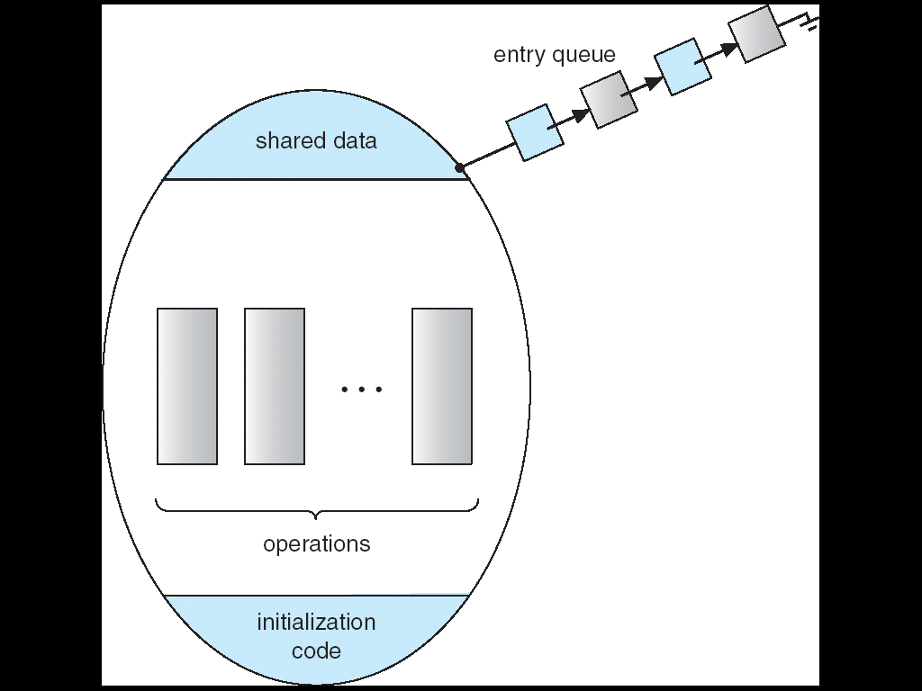
Monitors
The monitor construct ensures that only one process at a time is active within the monitor. The programmer does not need to code this synchronization constraint explicitly.
figure: Schematic view of a monitor
The monitor construct, as defined so far is not sufficiently powerful for modeling some synchronization schemes. For this purpose, we need to define additional synchronization mechanisms. These mechanisms are provided by the condition construct. A programmer can define one or more variables of the type condition

Slide 94
Thank you

